Slide 1
EMBODIED AI · WEEK 24
Four experiments, and what each
of them refuses to do
Experiment 1 — stand with no learning at all, and the playground I built so students can feel it
rather than read it. Experiment 2 — let something learn instead. Experiment 3 — attack both
and find what actually breaks. Experiment 4 — copy a human, and measure whether a robot could.
Shaoqin Li · Prof. Yi Sun · CCNY

Slide 2
Where the course stands
Four experiments. All four now have a written student lab and a tested file bundle.
Stand without learning
1
DONE · lab + package shipped
two dials, 49 settings, no AI at all
Teach it to stand
2
DONE · lab + package shipped
PPO, 3M steps, the same test as Experiment 1
Where it breaks
3
DONE · lab + package shipped
delay, one corrupted sensor, a different simulator
Make the robot copy a human
4
DONE · lab + package shipped
retargeting a motion capture onto the R1
All four run on a student laptop with no GPU and no admin rights. Experiments 1–3 need about 100 MB of packages; Experiment 4 needs a 3.6 GB research repo, installed at home before the session.

Slide 3
EXPERIMENT 1
Stand Without Learning
Two numbers, applied 500 times a second — and nothing else
The point is not that it works. The point is exactly how far it gets before it cannot.

Slide 4
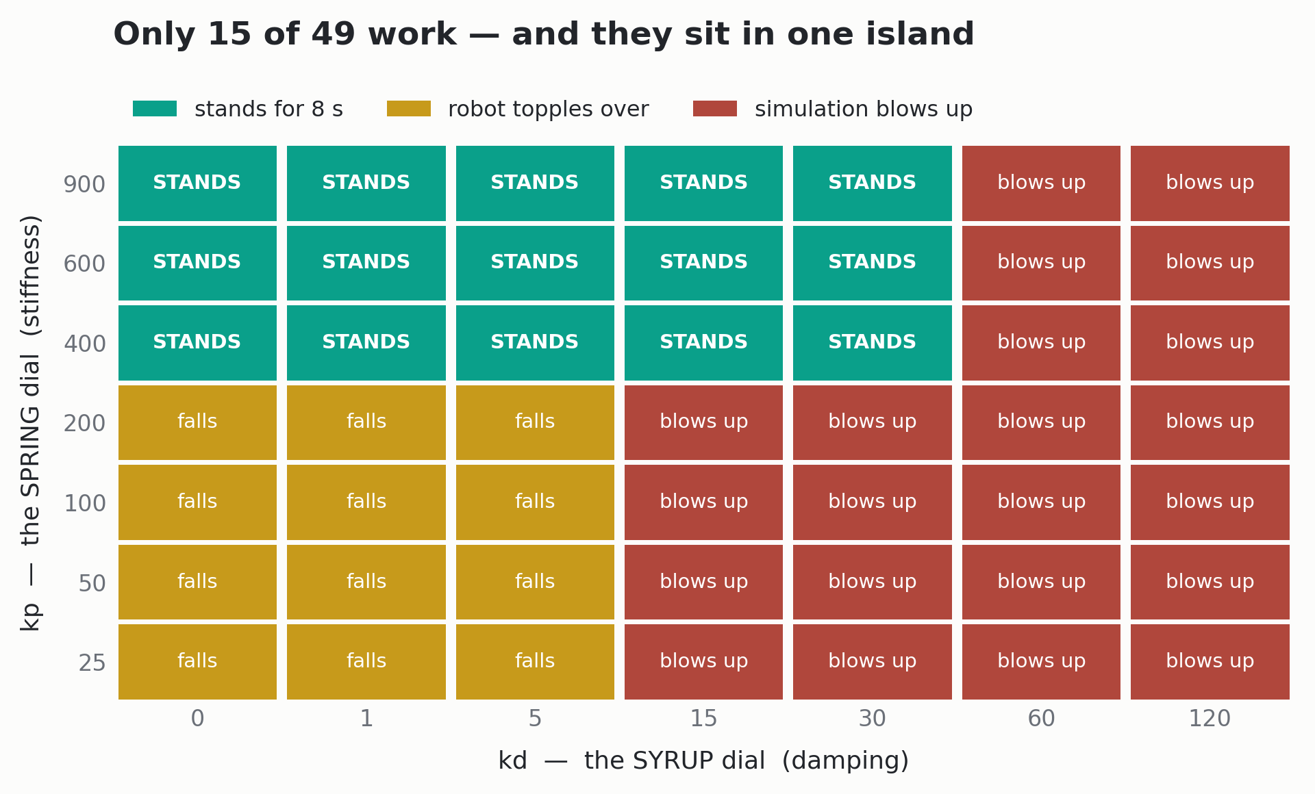
Experiment 1, in one picture
One stiffness dial, one damping dial, applied to all twelve leg joints. I ran all 49 combinations.
THREE REGIONS
15 stand
12 topple over
22 blow up the simulator
The most common outcome is not
the robot failing. It is the TOOL
failing — and telling them apart
is the whole lesson.
The floor is horizontal — physics.
The ceiling is vertical — arithmetic.
Two unrelated causes.
A student can read that chart in ten seconds and feel nothing. That was the problem I set out to fix.

Slide 5
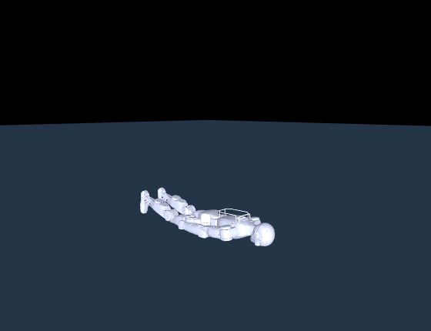
The two ways it fails are not the same thing
Confusing them is the most common mistake in the lab — and the most useful thing to get right.
TOPPLE — kp = 100
Every number is real. diverged = False.
A real robot would do exactly this.
It fell using 17 N·m — LESS than the 31 N·m
the one that stood used. Not weakness. Lean.
BLOW UP — kd = 120
diverged = True, every measurement nan,
"failed" after 22 simulator steps.
▶ the robot toppling — real physics, a real fall
Nothing physical happened. The arithmetic
ran away. No real robot can do this.
captured output — the topple
stood False
fall_t 1.142
max_tilt_deg 90.93
peak_torque_Nm 17.4
diverged False

Slide 6
The problem with handing someone a chart
They can recite the answer without ever having produced it. So I built the thing that makes them produce it.
WHAT A STUDENT HAD
WHAT I WANTED THEM TO HAVE
A six-minute batch sweep and a CSV.
Run it, wait, read 49 rows of text.
The interesting moment — the robot
leaning further and further until it
goes — happens invisibly, inside a
number.
A dial they can turn with a finger,
and a robot that reacts instantly.
Change one thing. See the result.
Change it back. That loop is what
builds an intuition — and it has to
be fast enough to stay a loop.
THE DESIGN RULE I ENDED UP WITH
Every keypress resets the robot to the same starting pose.
Without that, a student changes a dial while the robot is already halfway to the floor, sees it fall, and concludes the dial did it.
With it, the only thing that differs between two runs is the number they just changed — so what they see is caused by the dial, and nothing else.
That is a controlled experiment, and they run one every time they press a key without ever being told the phrase.

Slide 7
exp1_playground.py — the whole tool is the keyboard
129 lines. It opens a real MuJoCo window, and the arrow keys are wired straight to the two dials.
↑ / ↓
stiffer / softer spring
kp
AND ONE MODE FOR THE INSTRUCTOR
--tour
← / →
less / more syrup
kd
walks all 49 settings by itself,
about four seconds each.
It is the CSV from the batch sweep,
played as a movie — same numbers,
but now you watch the island
appear and disappear.
R
restart this setting
P
shove it, 0.20 m/s, right now
T
toggle the automatic tour of all 49
Two things to try, and they teach opposite lessons
Walk DOWN the kp column at kd = 5 — the lean grows visibly before each fall. Then sit at kp = 600 and walk RIGHT along kd — 0, 1, 5, 15, 30 look identical, then 60 detonates with no warning.

Slide 8
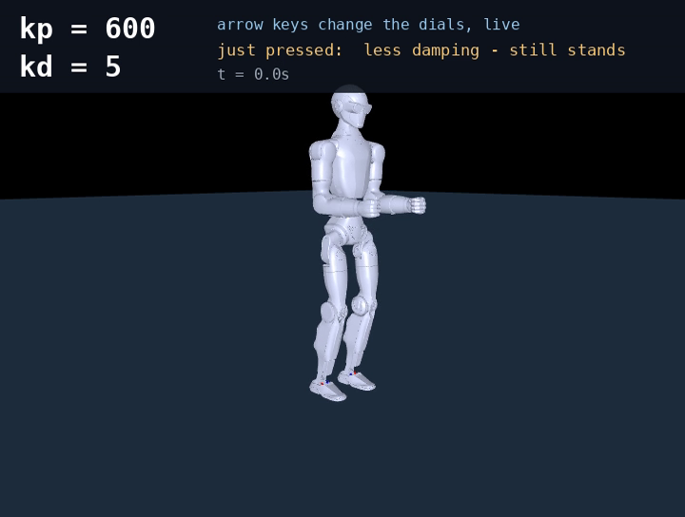
The playground, running
Recorded by the tool itself. Same physics, same key handling, same reset-every-press rule — rendered offscreen instead of shown in a window.
WHAT HAPPENS, IN ORDER
kp 600, kd 5
stands, barely moving
↓ kp 400
still stands
↓ kp 200
falls at 1.46 s
↓ kp 100
falls at 1.16 s — sooner
↑↑↑ back to 600
stands again
→ kd 60
BLEW UP — the simulator
P shove
0.20 m/s and it goes down
25 seconds. Every number on screen is live.

Slide 9
Building it changed the lab
The tool was supposed to be a nicer way to show a known result. It produced two findings of its own.
FINDING 1 · the default had to change
FINDING 2 · every commanded motion topples it
kd = 30 stands perfectly — but it sits ABOVE
the stability bound and survives only because
a still robot has almost no velocity.
I tried making the target pose move — knees,
hip yaw, ankle roll — from 0.25 rad down to
0.05 rad.
The gentlest motion still falls, at 2.66 s.
This controller has so little margin that
moving on purpose loses it.
change kd = 30 kd = 5
mass x1.5 blew up falls 8.60s
icy floor + push blew up stands
knee sine wave blew up falls 1.32s
A sandbox default must be numerically robust,
not merely a setting that stands.
Which is exactly why Experiment 2 exists
A student finishes Experiment 1 having personally failed to hand-write a rule that survives a shove. That failure is the setup —
they are not told a learned policy is better, they are shown the wall first and then handed something that gets over it.

Slide 10
EXPERIMENT 2
Teach It To Stand
Same robot, same physics, same test — but now something learns
The only honest comparison is one where I changed exactly one thing.

Slide 11
What actually changed between Experiment 1 and 2
Not the robot, not the physics, not the test. Only what decides the target pose.
EXPERIMENT 1
EXPERIMENT 2
what decides the pose
what decides the pose
a constant I typed
a neural network, 50x a second
how many numbers
how many numbers
2 (kp and kd)
45 in → 256 → 256 → 12 out
where they came from
where they came from
I tuned them by hand
3M steps of PPO, 49 minutes
can it change its mind
can it change its mind
no — STAND_POS never moves
yes — a new target every 20 ms
survives a push of
survives a push of
0.15 m/s
0.30 m/s
Everything else is byte-identical — same environment file, same reward code, same XML, same evaluation script.

Slide 12
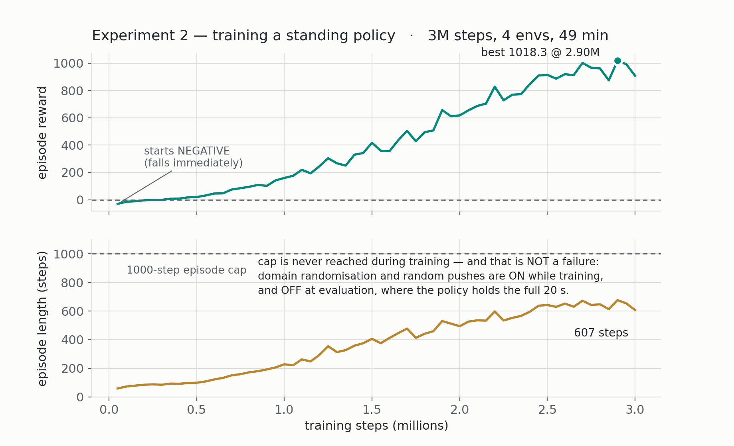
Training it, and the one number that lies
4 environments on the CPU, 3 million steps, 49 minutes. No GPU anywhere in this course.
THE CURVE RISES THE WHOLE WAY
So I evaluated the saved checkpoints
one by one instead of trusting it:
ckpt reward survival
1.0M 159 20.00s OK
1.5M 417 1.46s BROKEN
1.65M 436 1.57s BROKEN
2.0M 617 20.00s OK
Training reward hit an ALL-TIME BEST
twice while the policy could not stand
for two seconds.
Why: training reward is measured with randomisation and pushes ON, averaged over recent episodes. Evaluation runs with them OFF.
Different quantities — and here they disagree completely. The only way to know whether a policy works is to evaluate it.

Slide 13
The test is copied from Experiment 1, deliberately
If I had invented a nicer test for the learned policy, the comparison would be worth nothing.
same robot model
r1 standalone, 12 leg joints, identical XML
THE ONLY DIFFERENCE
what produces the
target pose.
That is the entire
experiment.
same starting pose
the same slight crouch, reset the same way
same shove
sideways velocity added at t = 1 s, in m/s
same fall detector
pelvis below 60% of start height, or 45° of tilt
same trial length
and the same number of episodes
This is the same discipline as the null control in Experiment 3, and the same reason Experiment 2 reused Experiment 1's environment file:
a result is only as good as the thing you are comparing it against.

Slide 14
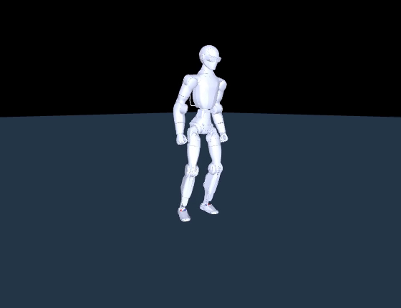
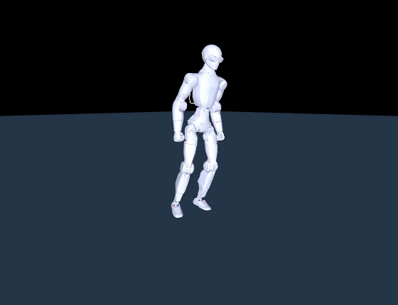
The push — and this is the headline
The identical shove that beat the hand-tuned controller in Experiment 1.
▶ learned policy, 0.30 m/s — stays up
▶ learned policy, 0.40 m/s — down at 2.06 s
0.15 m/s
→
0.30 m/s
Twice the shove, on the same robot, with the same test.
And it fails at 0.40 — so this is a measured limit, not a claim that it is unbreakable.
Experiment 1
hand-tuned, best case
Experiment 2
learned policy

Slide 15
Why it survives, and why no amount of tuning could have
This is a structural difference, not a better-tuned version of the same thing.
THE PD CONTROLLER
THE LEARNED POLICY
knows exactly one instruction:
outputs a new target pose
“get back to the pose
I was told to hold”
fifty times a second
It sees where it is — joint angles, joint
speeds, which way is up — and picks the
pose that helps from there.
Shoved sideways, it can crouch, shift its
weight, and lean back into the push, because
nothing forces it to want the pose it started in.
Nobody wrote that recovery. It was found.
Recovering from a shove means choosing a
DIFFERENT pose — stepping, bending, shifting
weight onto one foot.
STAND_POS is a constant. There is no
mechanism in the whole controller for
deciding to change it.
So this is not a tuning failure. It is a limit
of what that kind of controller IS.
Worth saying out loud: the learned policy is not smarter. It is doing something the other one cannot express at all.

Slide 16
EXPERIMENT 3
Where It Breaks
Three attacks on two finished policies — and the third result is not a failure at all
Nothing trains. Nothing is random. Every number reproduces exactly on a student laptop.

Slide 17
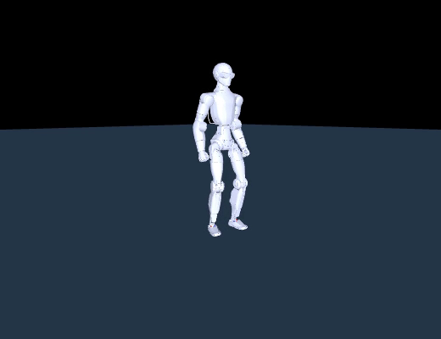
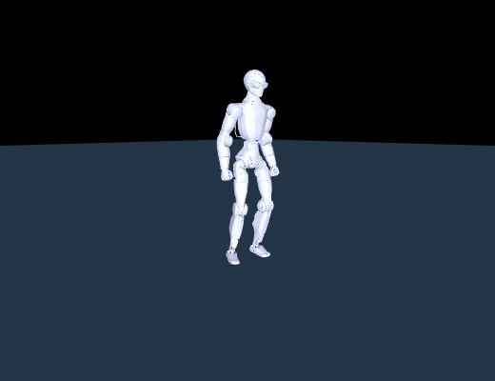
Attack 1 — make the controller late
A real robot cannot act instantly: sensor → network → compute → motor all cost time.
python exp3_sweep.py latency
delay standing walking
------------------------------------
0 ms survived survived
20 ms survived survived
40 ms survived 4.12s
60 ms survived 1.56s
120 ms survived 1.80s
160 ms 2.44s 1.94s
▶ no delay — walking normally
Standing tolerates 120 ms. Walking tolerates 20 ms.
Same robot, same simulator. The difference is what each
policy is stabilising:
Standing holds a FIXED POINT — errors decay.
Walking holds a LIMIT CYCLE — delay shifts the phase, and
phase error compounds every step.
One deterministic rollout per row — which is why it reproduces exactly.
The 20-episode research run reads 80 ms vs 20 ms: 4× rather than 6×.
▶ 160 ms of delay — down

Slide 18
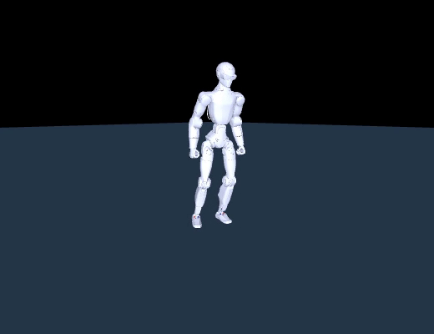
Attack 2 — corrupt one sensor at a time
Five channels. Which one, corrupted, kills a balance policy first? I asked people to predict before running it.
python exp3_sweep.py noise
clean max tilt 3.35 deg survived
command zeroed max tilt 3.35 deg survived
-> PASS, identical. The tool is honest.
sensor x1 x5 x10 x20
---------------------------------------
angvel 3/3 3/3 3/3 3/3
gravity 3/3 3/3 0/3 0/3 <- breaks
dofpos 3/3 3/3 2/3 0/3
dofvel 3/3 3/3 3/3 2/3
▶ clean sensors — stands
Gravity breaks first. Angular velocity survives everything.
Projected gravity is the only ABSOLUTE orientation reference in the
observation. Joint sensors are all relative to the body; angular velocity
is a rate you must integrate, and integration drifts.
▶ gravity ×10 — down at 1.92 s
Pre-registration predicted angular velocity. It was wrong — written down first.

Slide 19
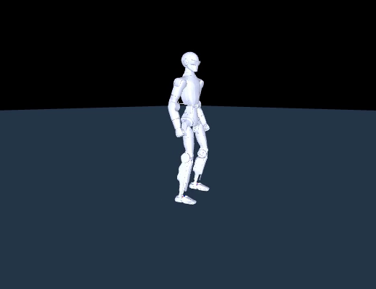
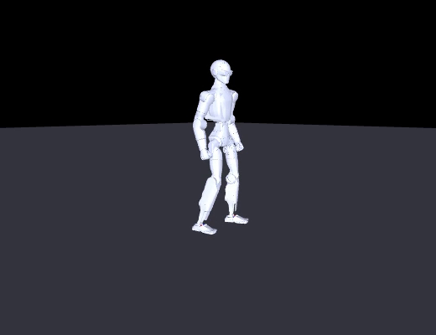
Attack 3 — swap the entire simulator
Same frozen weights, same kinematic tree, different collision geometry. Prediction: how long until it falls?
▶ model A — the training physics
▶ model B — the deployment physics
STANDING 20s: 0.008 m apart upright
NEITHER ONE FALLS.
WALKING 20s: 1.604 m apart upright
The sim2sim gap is not a fall. It is a drift.
And the control proves what bounds it: replay one simulator's actions blindly into the other — feedback off — and a robot topples in 2.68 s.
Feedback was cancelling the physics gap fifty times a second. Standing clamps divergence near 0.01 rad; walking near 0.10, and walking INTEGRATES it.

Slide 20
What Experiment 3 actually settles
Three attacks, and together they point away from the suspect everyone starts with.
ATTACK
STANDING
WALKING
WOULD REAL HARDWARE SEE IT?
Control delay
120 ms
20 ms
yes — every real system has latency
Corrupt gravity
breaks at ×10
—
yes — IMUs drift and get knocked
Different simulator
8 mm drift
1.6 m drift
yes, as drift — not as a fall
So where does the sim2sim gap actually live? Not in sensing.
The policy survived a ten-times corrupted joint sensor and a sixth of a second of delay. It did not fall when the entire world model changed.
This project spent weeks assuming otherwise — the walking policy transferred badly and domain randomisation was the obvious fix. It was not:
the policy walks 20 s on the exact deployment model. The gap was in the REAL-TIME CONTROL HARNESS — timing, not perception.
Attack 1 was the clue, handed over first: delay is precisely what walking cannot tolerate.

Slide 21
EXPERIMENT 4
Make the Robot Copy a Human
Take a real human motion capture and put it on the R1
The first three experiments asked whether it stays up. This one asks whether the motion was ever possible.

Slide 22
Retargeting, and what had to be added for the R1
A motion capture records a person. The R1 is not a person — different limbs, different axes, 24 motors.
THE PROBLEM IT SOLVES
WHAT IT IS NEVER ASKED
For each frame: what joint angles put THIS
robot's body closest to where the human's was?
Anything about gravity, contact, torque, or
whether the robot could stay upright.
GMR is the research tool that does this. It ships with several robots — the R1 was not one of them. Support for it is four things added by this project:
assets/unitree_r1/r1_scene.xml
the robot model
THE IK CONFIG IS THE CONTRIBUTION
A JSON file saying which human body
part drives which robot body, and
how much each one matters.
That mapping is what a new robot
needs. Writing one is the work.
ik_configs/bvh_xsens_to_r1.json
Xsens motion capture → R1
ik_configs/smplx_to_r1.json
SMPL-X / AMASS → R1
5 entries in params.py
model path, IK configs, root body, camera
R1 accepts SMPL-X and Xsens BVH. It does NOT accept LAFAN1 — the dataset most GMR tutorials use. No LAFAN1→R1 mapping has been written yet.

Slide 23
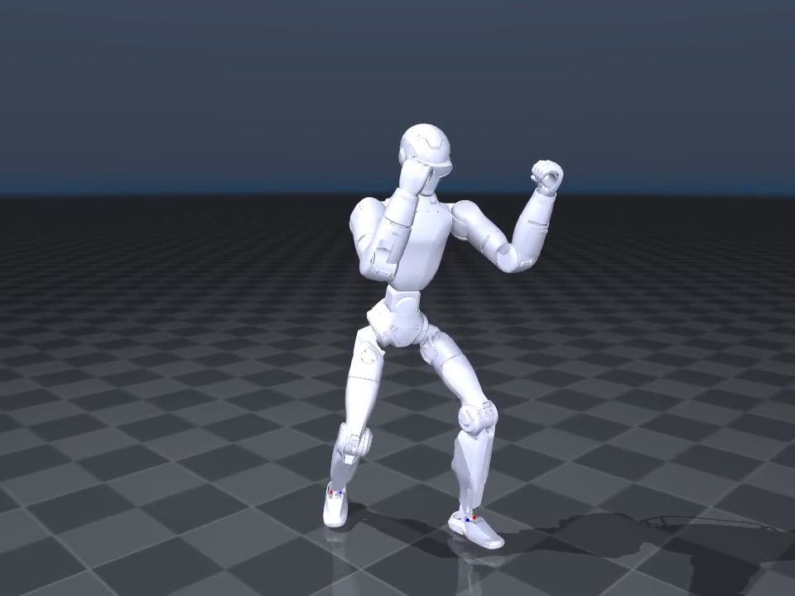
Run it, and watch a robot box
GMR ships one motion capture: 35 seconds of boxing at 120 Hz. I retargeted ten seconds of it.
[headless] IK solve rate: 217.1 FPS
(5.5s for 1200 frames), motion is
120 fps -> real-time capable
[headless] motion saved to out/mine.pkl
217 FPS against a 120 fps motion — nearly
twice real time. This could run LIVE off a
streaming mocap suit, not just offline.
AND ONE MEASUREMENT WORTH KEEPING
Pass --video_path and it drops to about
4 FPS. Fifty times slower. The bottleneck
is drawing pixels, not the mathematics.
It is genuinely convincing.
▶ the retargeted motion — does that look like a real robot boxing?
The guard comes up, the weight shifts, the
feet stay planted. Nothing looks wrong.

Slide 24
Now measure it
Four questions the video cannot answer: do the feet touch the ground, does the body move, is any joint over its stop, could a motor move that fast?
python exp4_check_motion.py reference/r1_boxing.pkl
VERDICT
1. FEET -- does the robot ever touch the ground?
lowest contact point: min -1.15 cm max +1.80 cm
-> touches down on 762/1200 frames (64%)
2. PELVIS -- does the body rise and fall like a real one?
height 0.648 .. 0.733 m (range 8.49 cm)
-> moves, as a real body would
3. LIMITS -- any joint past its mechanical stop?
-> none. every joint stays inside its range.
4. SPEED -- could a motor actually move this fast?
peak joint speed 27.3 rad/s (limit set to 20)
-> exceeded on 5 frames
NOT physically realisable
the foot penetrates the floor by 1.15 cm
and 5 frames need an impossible speed
TWO OF THE FOUR PASS
The pelvis moves 8.5 cm, like a real body.
No joint is driven past its stop.
Whoever built this did not do it carelessly.
Why that is not a bug
Retargeting was given one problem: put the robot's limbs where the human's were. It solves that well — which is why the video convinces.
Nothing in the pipeline ever asked about the floor, so nothing in the output respects it.
A tool that solves the problem you gave it is not broken when it fails a problem you never mentioned.

Slide 25
The wrong answer I reported first
Students are told to go and reproduce this deliberately. It is the most useful five minutes in the lab.
the same tool, run on frames 0-360
WHAT ACTUALLY HAPPENED
1. FEET
lowest contact point: min +4.53 cm max +4.63 cm
-> FLOATING the whole time. 0 of 360 frames contact.
2. PELVIS
height 0.787 .. 0.787 m (range 0.06 cm)
-> FROZEN. A moving human does not hold this constant.
4. SPEED
peak joint speed 0.6 rad/s (limit set to 20)
Every Xsens capture opens with the
performer standing still in a calibration
T-pose. I measured that, not the boxing.
Every number above is true of the T-pose
and false of the motion.
THE GIVEAWAY was check 4, the one I was
not even looking at: 0.6 rad/s is impossibly
slow for someone throwing punches.
An implausible number in a check you are
not focused on is what exposes a mistake
in the one you are.
A far better story — and completely wrong.
“The robot never touches the ground and its pelvis never moves.”
The tool now refuses to answer
VERDICT: withheld -- you measured a calibration pose.
A measurement tool that cannot say “I do not trust this input”
will eventually hand you a confident wrong answer.

Slide 26
So what is a retargeted motion good for?
It is a reference, not a controller. It says what the robot should look like — nothing about how to stay standing.
RETARGETING — Experiment 4
RL POLICY — Experiment 2
WHAT IT GIVES YOU
WHAT IT GIVES YOU
a rich, human-like motion, from
cheap capture or video
balance, push recovery, real
physics it cannot cheat
WHAT IT CANNOT DO
WHAT IT CANNOT DO
respect gravity, contact, or torque
invent an interesting motion to perform
Retarget to get the reference, then train a policy to track it while actually balancing.
The reward gains one term — stay close to the reference pose — on top of everything Experiment 2 already had.
That two-stage design is the architecture behind essentially every humanoid-imitation paper in the reading packet. A student who finishes the
course has built both halves and measured why neither is sufficient alone — and can reject an impossible motion in ten seconds, before spending an hour training a policy to track it.

Slide 27
Where this leaves the workshop
SHIPPED — READY FOR STUDENTS
WHAT IS ACTUALLY LEFT
Four labs, each a Word/PDF manual with a
cover, contents and boxed commands, plus a
file bundle tested from an empty folder.
Lab 1 45–60 min 50 files 9.9 MB
Lab 2 60 min 52 files 12.0 MB
Lab 3 60 min 50 files 10.5 MB
Lab 4 60 min 5 files 2.2 MB
Every Expected block in all four was
produced by actually running the command.
Nobody has run all four end to end in one
sitting yet — Experiment 1 has been done on
a clean Windows machine, the rest on mine.
macOS is untested across every lab.
And there is one genuinely unclaimed piece
of work: no LAFAN1 → R1 mapping exists, so
the largest public BVH dataset is closed to
us. Writing that config would open it.
The thread running through all four experiments
Each one found a number that looked like the thing I cared about and was not: a NaN check blind to a blown-up simulator; a training reward
at an all-time best while the policy could not stand; a “max tilt” printing the final tilt; a floating robot that was really a calibration pose.
The last one was mine, reported as a finding before I caught it. That is the course.

